Slide 1
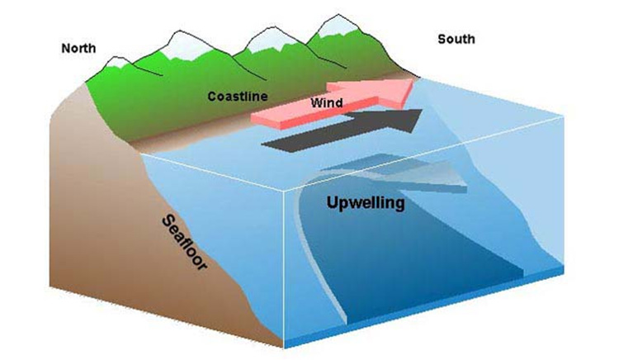
Upwelling - deep, cold water rises toward the surface

Slide 2
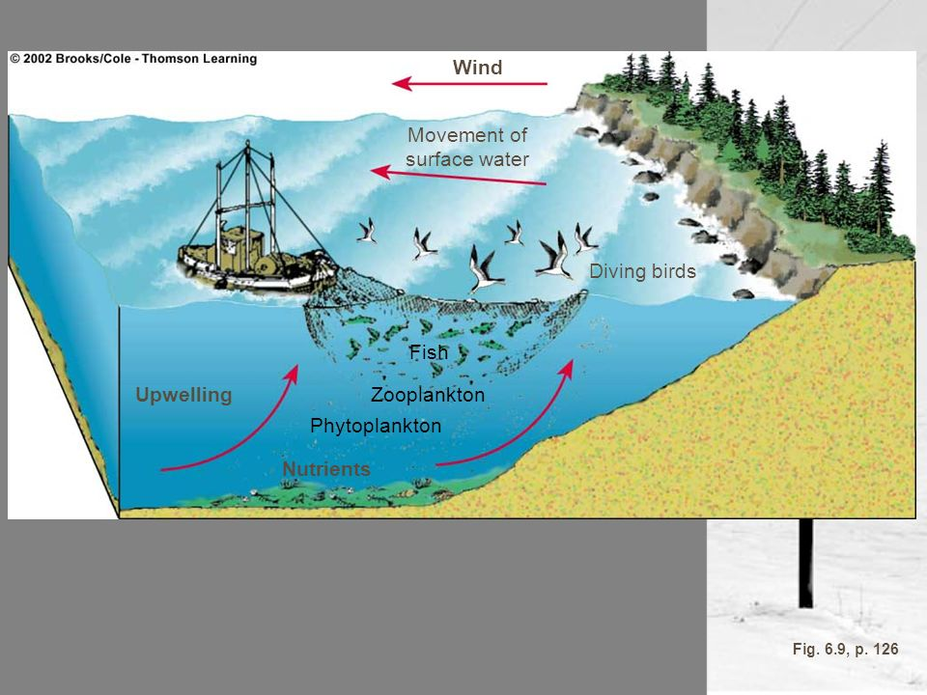
Water that rises to the surface is:
Colder
Rich in nutrients
Nutrients “fertilize” surface waters
High biological productivity
Good fishing grounds

Slide 5
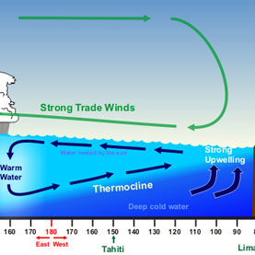
Southern Pacific Ocean -
Normal

Slide 6
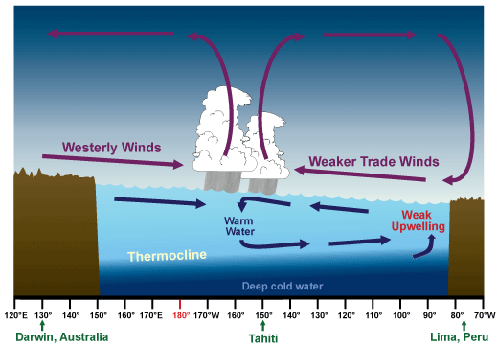
Southern Pacific Ocean -
El Nino

