Slide 2
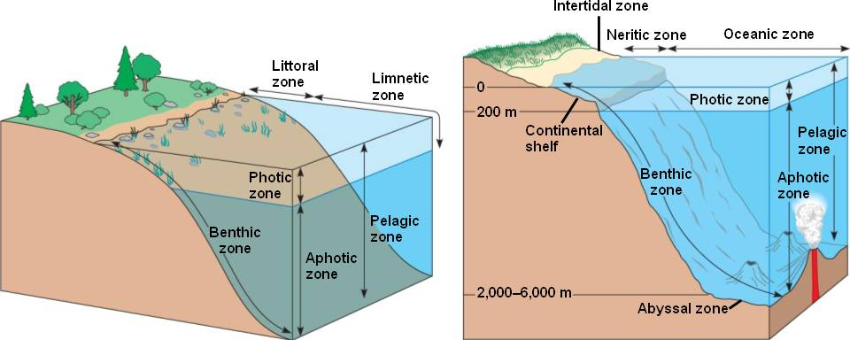
Photic zone, surface layer of the ocean that receives sunlight. The uppermost 80 m (260 feet) or more of the ocean, which is sufficiently illuminated to permit photosynthesis by phytoplankton and plants, is called the euphotic zone.

Slide 4
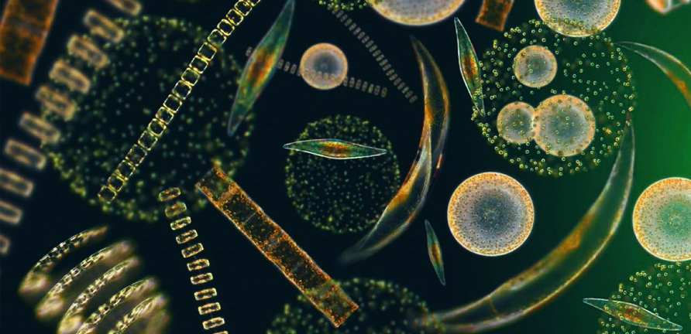
Phytoplankton

Slide 5
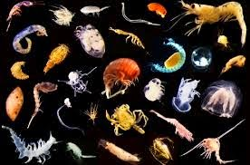
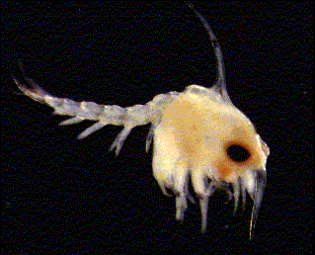
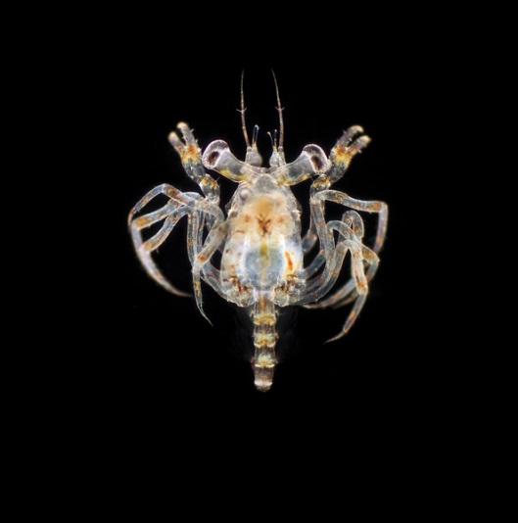
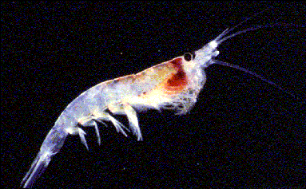
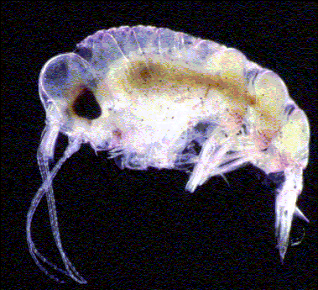
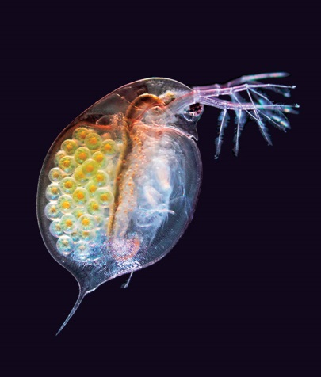
Zooplankton

Slide 6
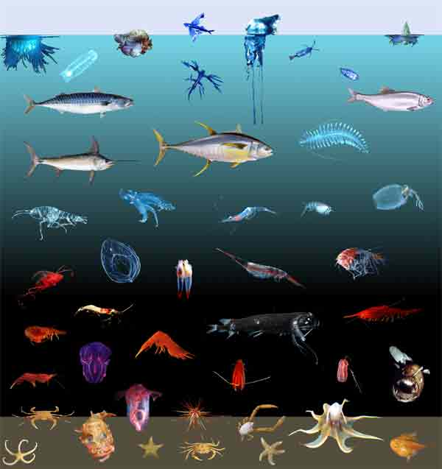
Food for other marine organisms

