Slide 1
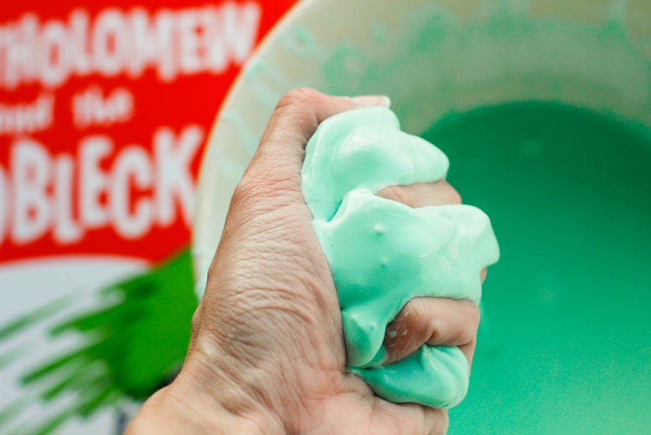
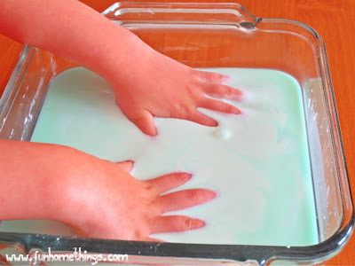
P
 | A
 |  | S
 |  |  | S
P
 | A
 |  | S
 |  |  | S
Oobleck
Called Oobleck because it looks like the green rain Dr. Seuss described in his book “Bartholomew and the Oobleck”

Slide 2
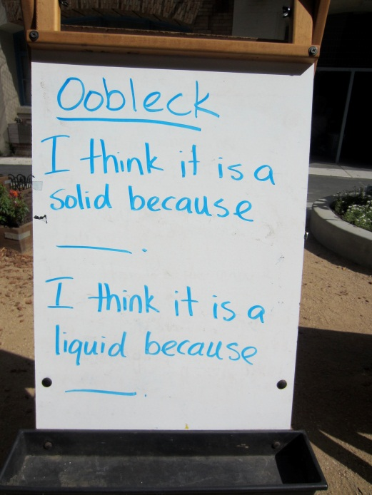
P
 | A
 |  | S
 |  |  | S
P
 | A
 |  | S
 |  |  | S
Oobleck
Students will:
Investigate the substance
Record its properties
Hold a scientific convention to create “A Law of Oobleck”
Design a space craft to land on the moon made of Oobleck

Slide 3
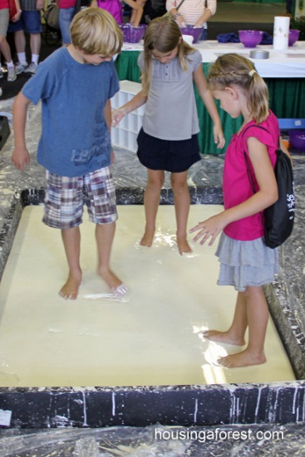
Oobleck
Potential activities in other areas:
Writing and math - to help understand differences between facts, laws and theories
Research and writing on the history of space exploration
Write a letter applying for a job explaining how they gained experience as a scientist when they investigated Oobleck
Imagine and create animals that could live on the surface of Oobleck
Create 3-D models of the space craft
Instruction on units of measurement including distances to planets
P
 | A
 |  | S
 |  |  | S
P
 | A
 |  | S
 |  |  | S

Slide 4
P
 | A
 |  | S
 |  |  | S
P
 | A
 |  | S
 |  |  | S
Let’s Investigate Oobleck

