Slide 1
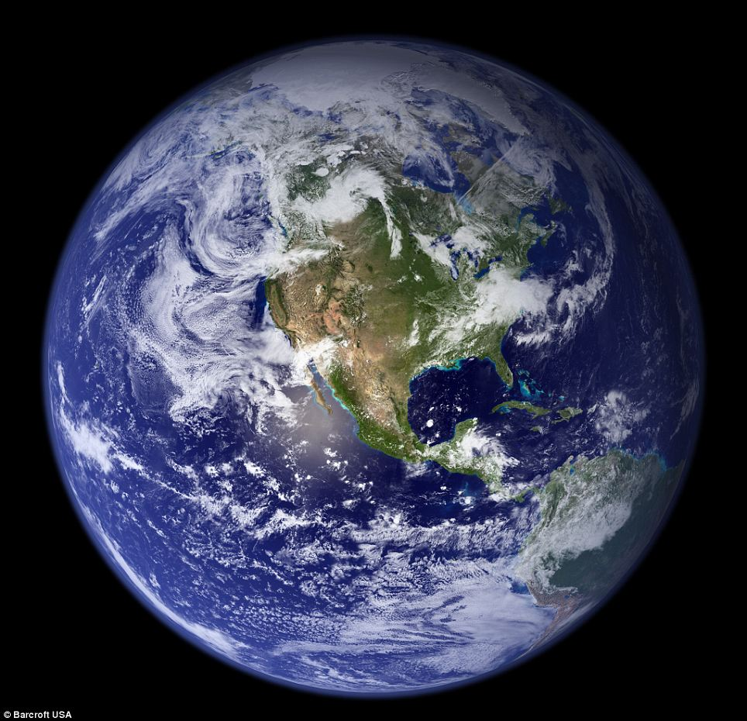
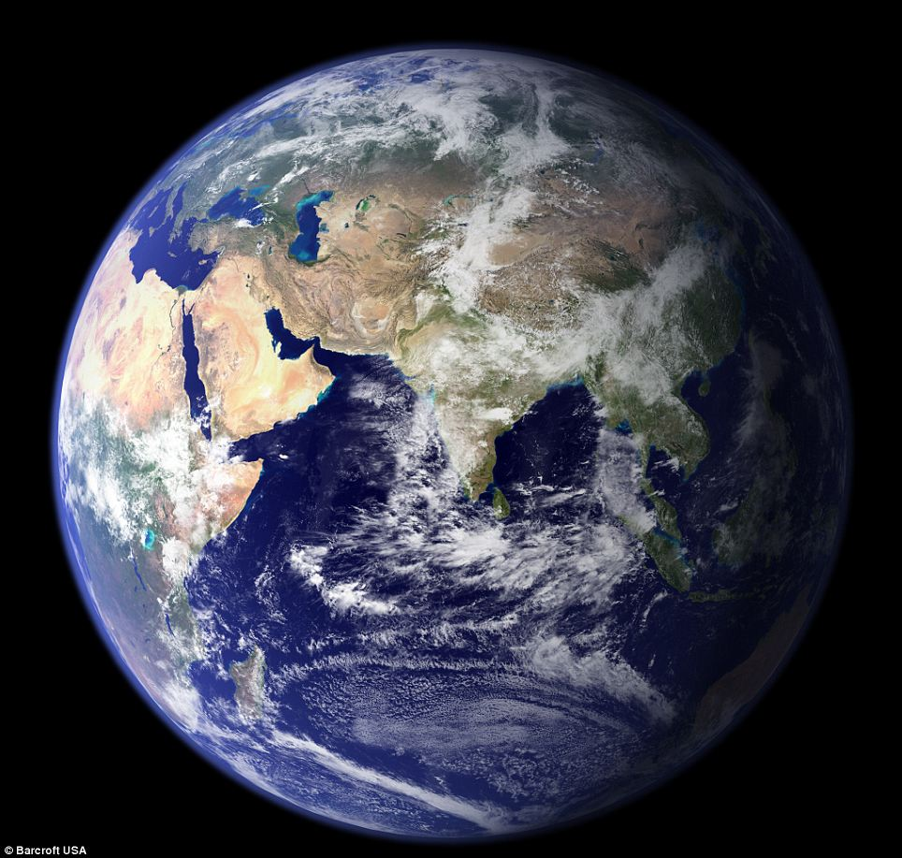
Planet Earth???
Notes:
Supplies:
Inflatable globe
Mounted globe
Colored beads (blue and brown at least; option for white and green also)
4 pipe cleaners

Slide 2
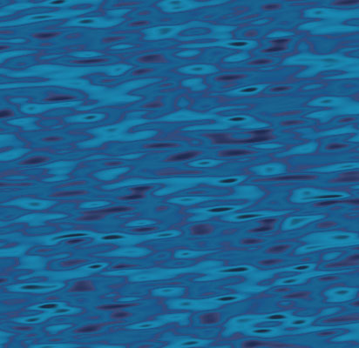
The Blue Planet
29% Land
71% Water
Notes:
Supplies:
Inflatable globe
Mounted globe
Colored beads (blue and brown at least; option for white and green also)
4 pipe cleaners
1-L beaker or Erlenmeyer flask, filled with blue-colored water
salt
25 or 50 ml graduated cylinder
Ice packs
10 ml graduated cylinder
Eyedropper
2-gallon bucket

Slide 3
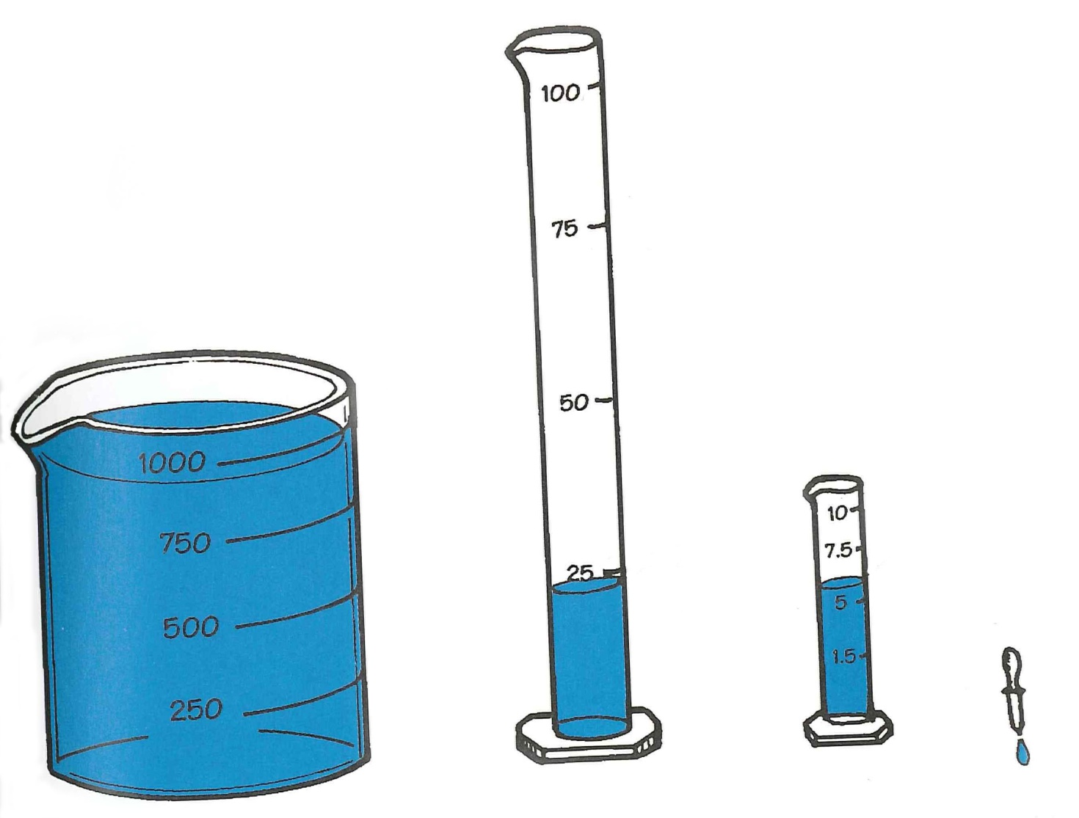
A Drop in the Bucket
But How Much for Us?
2.4% Frozen
<0.6% Unavailable
97% Ocean
0.003%
Fresh, Unfrozen, Readily Available
Notes:
Supplies:
1-L beaker or Erlenmeyer flask, filled with blue-colored water
salt
25 or 50 ml graduated cylinder
Ice packs
10 ml graduated cylinder
Eyedropper
2-gallon bucket

