Slide 1
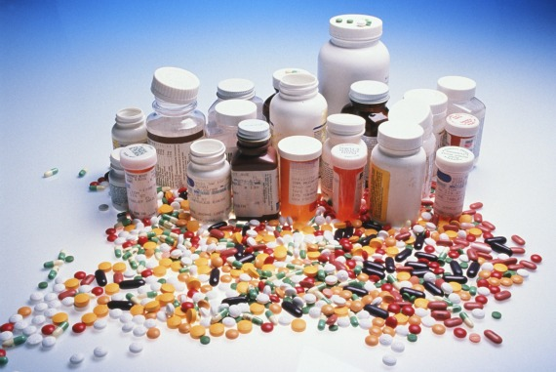
TOXICOLOGY – THE STUDY OF SUBSTANCES THAT ARE HARMFUL TO LIVING ORGANISMS

Slide 2
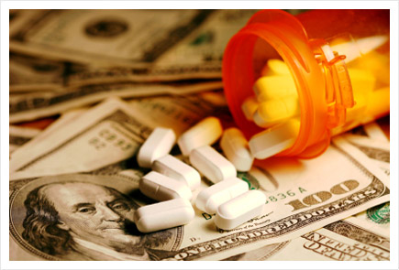
Prescription drugs
Americans spend over 75 million dollars a year on medicine/drugs

Slide 3
Regulations of medicine are intended to protect people from dangerous or worthless drugs
Before the market, they must pass careful scientific testing
1 out of 5,000 drugs tested is approved
Are the regulations to strict, keeping drugs off the market when they can be helping people?

Slide 4
1st step is to test the drug on animals
Before regulators approve a drug, it typically has been tested on hundreds of animals. The FDA requires initial testing in at least two species: one rodent, one nonrodent. By the end of the process, mice, pigs, rabbits, dogs, monkeys and other animals may have been used (Wall Street Journal, March 30, 2007).

Slide 5
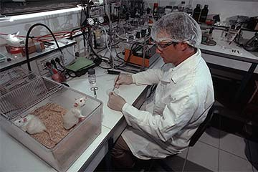

Slide 6
2nd step is clinical trials on humans
Children's dosage is tested on children
If FDA (Federal Drug Administration) agrees it is safe the drug is approved.
The discovery, development and approval process for prescription drugs can take 12 – 15 years before it is made available to the US public

Slide 7
Even with this long process and after a medicine is approved, sometimes it is taken off the market due to harmful effects not discovered during testing
Herbal remedies and dietary supplements are not regulated as strict as prescription drugs
Testing needs to determine the effects of acute of a single dose and the chronic or long term effects of many doses over an extended amount of time

Slide 8
TODAY WE WILL DO A TOXICOLOGY TEST ON LAB RATS
We will determine the threshold dose for the acute effects of an herbal remedy, “lily juice”
Lily juice contains an active ingredient that supposedly increases intelligence
We will simulate a test to evaluate the effects of lily juice consumption.
Rats’ responses to many substances are similar to those of humans
Your rats weigh 400 grams 14 oz. or .88 lb

