Slide 1
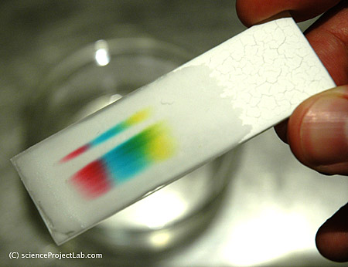
Crime Lab Chemistry
Michelle Albritton, Jessica Hinds, Debbie Terwilliger and Crystal Twitty

Slide 2
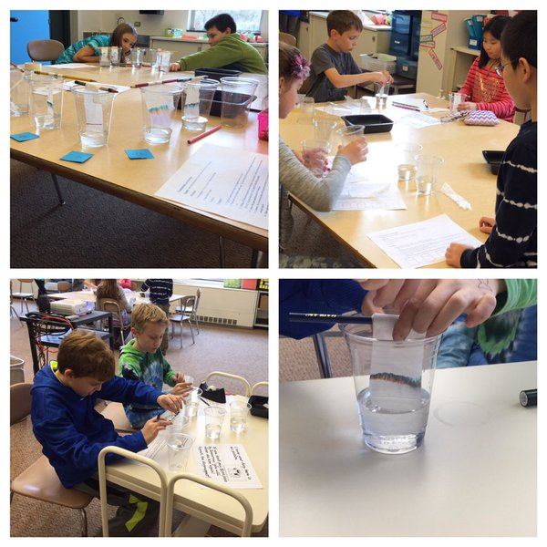
Summary
Crime Lab Chemistry
3 Activities
Laboratory Investigation
What is chromatography
Designing your own test

Slide 3
Activities
Ink Mark
Paper wads, rocks, ping pong balls, styrofoam balls, styrofoam packing peanuts (Molecule model)
Food Coloring- Purity

Slide 4
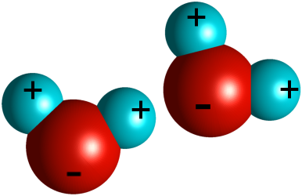
Activity 1 - Laboratory Investigation
DCI MS-PS1.A: Structure and Properties of Matter
MS-PS1.1; MS-PS1-4
SEP: Developing and using models
CCCs: Cause and effect
Scale, proportion and quantity

Slide 5
Suggestions for Improvement
1.Students should engage in meaningful discussion about the type of data they collected.
2.Before the investigation begins have students develop a claim based on the writer of the note and their motive.
3, Have students construct a written explanation after Session 1: Investigating the evidence and then revise their explanation after Session 2: Solving the mystery after applying scientific ideas and evidences from both exploration activities.
4. Students draw microscope eyes in interactive notebook.
5.Consider providing students with a template for graphic representation of the test strips with the pen markings to match up with the ransom note sample .
6. Some teachers create in-school mysteries in which school staff is the suspect.
7. Calculate the distance that the ink traveled.

Slide 6
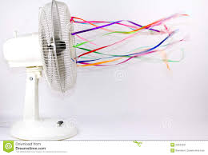
Activity 2- What is Chromatography
DCI- MS-PS1.A Structure and Properties of Matter
MS-PS1-1; MS-PS1-2; MS-PS1-3
SEP- MS.ETS1.C Optimizing the design solution
CCCs- System and System Models
Scale, Proportion and Quantity

Slide 7
Suggestions for Improvement
Show a video on chromatography and other ways that it is used. (Forensic science)
Calculate the distance that the objects traveled.

Slide 8
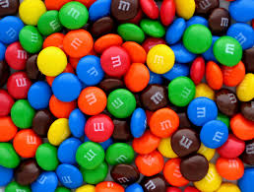
Activity 3- Designing Your Own Test
DCI- MS-PS1.A Structure and Properties of Matter
MS-PS1-1; MS-PS1-2; MS-PS1-3
SEP- MS.ETS1.B Developing possible solutions (MS-ETS1-2, MS-ETS1-3, MS-ETS1-4)
MS. ETS1.C Optimizing the design solution (MS-ETS1-3)
CCCs- Cause and Effect
Scale, Proportion and Quantity

Slide 9
Suggestions for Improvement
Instead of just drawing the “microscope eyes” in their chromatography test report, have the students include a scale showing how far each pigment (molecule) traveled.

Slide 10
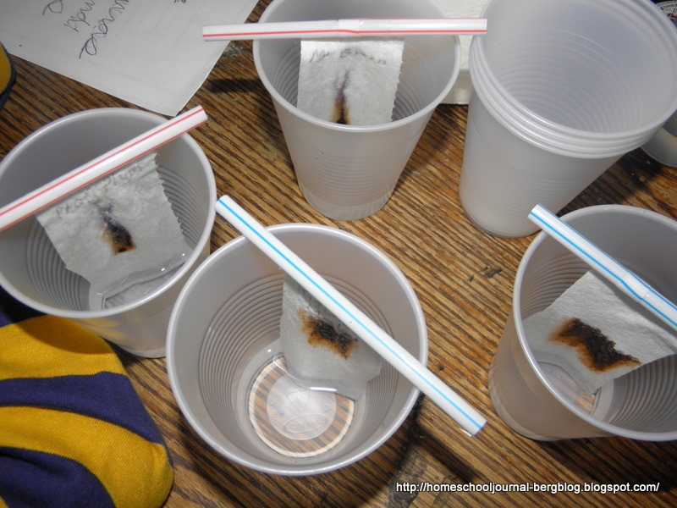
Dimensions Working Together
Engage: Activity 1 (Mystery Story)
Explore: Activity 1 (Mystery Pen)
Explain: Activity 2 (Molecular Model, Chromatography, and
Microscope Eyes)
Elaborate: Activity 3 (Design your own test)
Evaluate: Analyze molecular structure and re-evaluate initial models

