Slide 1
Citric Acid Taste Test

Slide 2
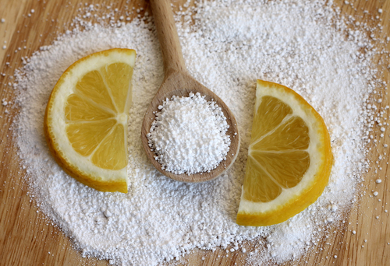
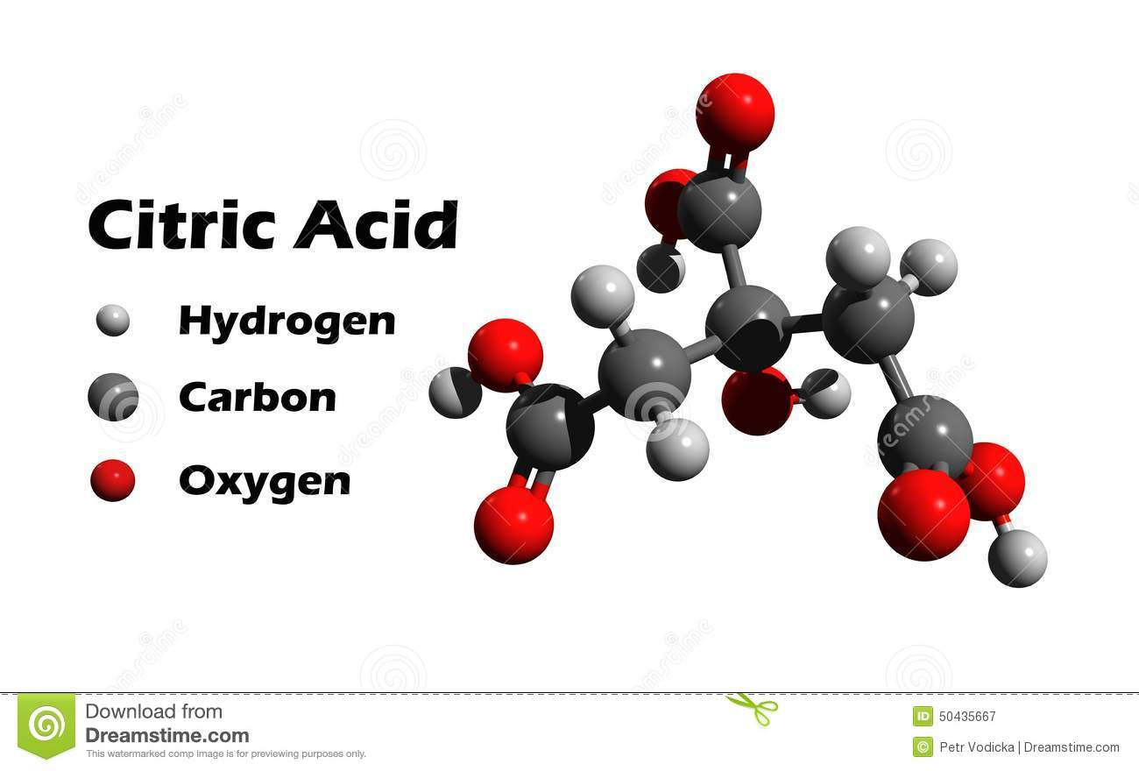
Citrus Acid

Slide 3
What products contain citric acid?
Stock cubes especially chicken.
Soft drinks - almost all of them
Jams and fruit preserves
Canned tomatoes
Canned fruit
Fruit flavor sweets - especially fizzy or sour ones. Citric acid is a major ingredient in sherbet!
Some ice creams Convenience foods: especially tomato-based sauces.

Slide 4
Threshold
Humans vary in their responses to different stimuli
The threshold of a stimulus is the lowest level that provokes a response

Slide 5
Concentration
A term used to quantify the amount of a substance that is dissolved
Adding water to a solution dilutes the concentration of any dissolved substances and can change the properties of the solution
The concentration of a dissolved substance can be expressed in ppm or ppb
1,000 ppm

Slide 6
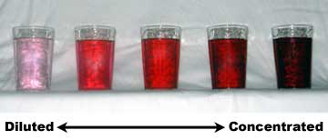
Why did the samples you tasted , taste different?
Different concentrations of citric acid

Slide 7
Solvent is a substance that dissolves a solute
A solvent is usually a liquid ( water)
A solute is a substance dissolved in a liquid
(citric acid powder)
Quantitative is a numerical value (quantity)
Qualitative is a non numerical value ( quality or qualities of something)(size, appearance)

